Slide 1
MAT OPIOIDS
Ken Dickinson, MS, RPh, Hon.DSc.
Gaudenzia, Inc.
610-291-3109
kdickinson@gaudenzia.org

Slide 2
Definitions
Opioid Use Disorder (OUD) is a chronic, relapsing disease defined in the DSM-5
Bio-psycho-social-spiritual illness
Addiction involving opioid use
All abbreviations and acronyms available in the ASAM National Practice Guideline

Slide 3
Premise
FDA-approved medications to treat OUD are clinical & cost-effective interventions
Saves lives, saves money
One component, along with psychosocial treatment
30% of treatment programs offer medication
Less than half of eligible treatment program patients receive medications
Missed opportunity to utilize most effective treatments

Slide 4
Assessment
Diagnosis
Treatment
Special Populations

Slide 5
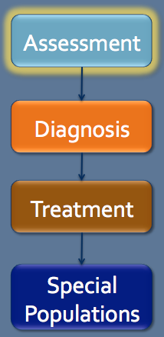
Assessment
Identify & refer urgent medical or psychiatric problems
Screen for concomitant medical conditions
Physical exam (comprehensive assessment)
Laboratory testing
Pregnancy testing & contraception query
Mental health & psychiatric assessment
Evaluation of past & current substance use

Slide 6
Assessment (cont’d)
Poorer prognosis with other substance use
Tobacco use query & cessation counseling
Social & environmental factors assessment

Slide 7
Assessment
Diagnosis
Treatment
Special Populations

Slide 8
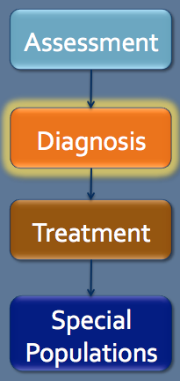
Diagnosis
Provider confirms OUD diagnosis
History & physical exam
Scales measure OUD withdrawal symptoms
Frequency of urine drug testing determined

Slide 9
Assessment
Diagnosis
Treatment Setting
Treatment
Treating Opioid Withdrawal
Treating w/ Methadone, Buprenorphine, Naltrexone
Special Populations
Psychosocial
Notes:
This one has built-in animation. Ok?

Slide 10
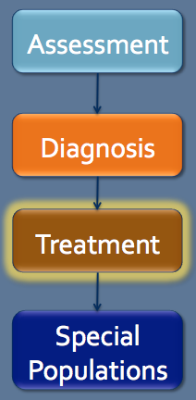
Treatment Setting
Clinician & patient share treatment option decisions
Consider patient preferences & treatment history & setting to determine medication
Venue as important as medication selected
Office treatment may not be suitable for patients with selected drug addiction issues
OTPs offer daily dosing and supervision

Slide 11
Opioid Withdrawal Management
Medications for withdrawal preferred to abrupt cessation
Advise patients medications alone for opioid withdrawal not a complete treatment method
Medical history & physical exam focus on withdrawal signs & symptoms
Methadone withdrawal symptom management in OTP or inpatient setting

Slide 12
Opioid Withdrawal Management (cont’d)
Buprenorphine can be used to manage withdrawal symptoms
Combination buprenorphine & low dose oral naltrexone to manage withdrawal & facilitate ER injectable naltrexone shows promise
Clonidine to support opioid withdrawal
Anesthesia ultra-rapid opioid detoxification (UROD) is NOT recommended - too high risk
Increased risk of OD or death with stopping agonist therapy & resuming opioid use

Slide 13
Assessment
Diagnosis
Treatment Setting
Treatment
Treating Opioid Withdrawal
Treating w/ Methadone, Buprenorphine, Naltrexone
Special Populations
Psychosocial
Notes:
This one has built-in animation. Ok?

Slide 14
Methadone
Methadone for physiological dependence with psychosocial intervention
Methadone in monitored program setting
Psychosocial treatment with methadone
Recommended initial dose 10-30 mg; usual daily dosage from 60-120 mg
Methadone for relapse or at risk for relapse
Relapse prevention strategies part of comprehensive treatment

Slide 15
Methadone (cont’d)
May switch from methadone to other medication if side effects or other issues
Low doses of methadone first if switching to buprenorphine
Complete withdrawal from methadone before switching to oral or ER naltrexone
No recommended/optimal treatment duration (depends on patient response)

Slide 16
Buprenorphine
Mild to moderate opioid withdrawal symptoms before buprenorphine
Start with 2-4 mg; increase dosage in 2-4 mg increments
Observe patients in office during induction, home inductions if experienced physician or patient
After induction ≥8 mg a day; 4-8 mg increases w/continued opioid use (daily dose 12-16 mg or higher)
Psychosocial treatment with buprenophrine

Slide 17
Buprenorphine
Reduce buprenorphine diversion
Frequent urine drug tests (including buprenorphine)
Frequent visits until stable
If/when taper, should be slow & monitored
7-14 days between buprenorphine to naltrexone
Buprenorphine to methadone no time delay
No recommended time limit for treatment

Slide 18
Naltrexone
Naltrexone rec to prevent relapse
Psychosocial treatment with naltrexone
Oral naltrexone taken daily in 50 mg doses or 3x weekly in two 100 mg doses, followed by one 150 mg dose
Naltrexone ER administered every 4 weeks at set dosage of 380 mg/injection
No recommended length of treatment
Plan and monitor naltrexone to agonist switches

Slide 19
Psychosocial in Conjunction with Medications
Recommended with any pharmacological treatment – at a minimum should include:
Psychosocial needs assessment
Supportive counseling
Links to existing family support
Referrals to community services

Slide 20
Psychosocial in Conjunction with Medications (cont’d)
Collaboration with behavioral provider
Psychosocial treatment generally recommended for patients receiving opioid agonist treatment
Offered with oral and extended-release injectable naltrexone

Slide 21
Medications for OUD Treatment
ªThe dose should be individualized and may be higher
or lower than this usual dosage.

Slide 22
Assessment
Diagnosis
Treatment
Special Populations

Slide 23
Pregnant Women
Identify & refer urgent medical conditions
Medical & psychosocial examination
OB/Gynecologists be alert to signs of OUD
Psychosocial treatment is recommended
HIV & hepatitis (B & C) testing & counseling
With patient consent, urine testing for opioids and other drugs
Treat OUD women w/methadone or buprenorphine rather than abstinence

Slide 24
Pregnant Women
Co-managed w/ OB/GYN & addiction specialist
Pregnancy affects pharmacokinetics
Methadone treatment initiated ASAP
Buprenorphine monotherapy is alternative to methadone
Discontinue naltrexone if relapse risk low
No naloxone unless overdose
Breastfeeding encouraged with methadone and buprenorphine

Slide 25
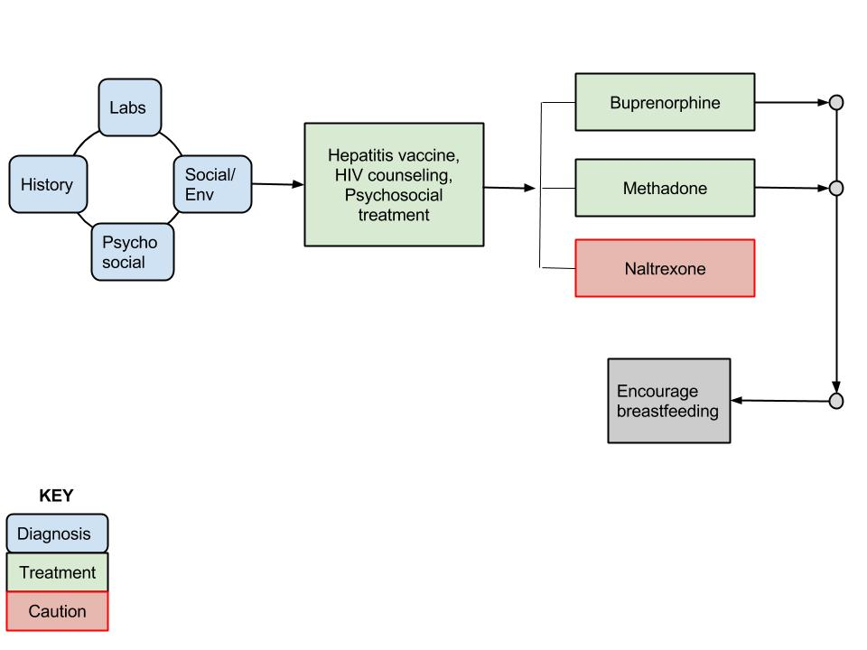
Treatment for Pregnant Women
Summary

Slide 26
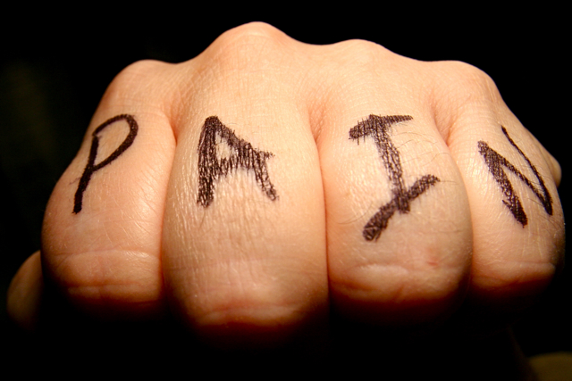
Individuals with Pain
Correct diagnosis & target suitable for treatment identified
Try non-narcotic medications first
Consider methadone or buprenorphine for patients with active OUD not in treatment
Pharmacotherapy with psychosocial counseling
OUD methadone patients will require opioids in addition to regular methadone dose
Methadone w/short-acting opioid for surgery
Increase buprenorphine for mild acute pain
Notes:
Photo: patient face in pain

Slide 27
Individuals with Pain
Discontinue buprenorphine, start high potency opioid for severe acute pain
Consult w/surgeon & anesthesiologist before discontinuing buprenorphine for surgery
Treat naltrexone patients with mild pain NSAIDs and with ketorolac for severe pain
Discontinue naltrexone 72 hours prior to surgery; ER naltrexone 30 days prior

Slide 28
Adolescents
Consider all treatment options
Opioid agonists, antagonists use appropriate
Psychosocial treatment recommended
Concurrent practices to reduce infection from STDs and blood-borne viruses
Benefit from treatment in specialized facilities with multidimensional services

Slide 29
Co-Occurring Psychiatric Disorders
Comprehensive mental health status assessment to determine if stable
Reduce, manage, & monitor suicide risk
Ask about suicide ideation and behavior
Assess psychiatric disorder at onset of agonist or antagonist treatment
Pharmacotherapy + psychosocial treatment for OUD & co-occurring psychiatric disorder

Slide 30
Co-Occurring Psychiatric Disorders
Be aware of interactions between psychiatric medications and OUD
Assertive Community Treatment (ACT) for schizophrenia and OUD w/history of hospitalization or homelessness

Slide 31
In Criminal Justice System
Pharmacotherapy effective regardless of length of sentenced term
Should get some type of pharmacotherapy and psychosocial treatment
Opioid agonists and antagonists may be considered for treatment
Pharmacotherapy initiated minimum 30 days prior to release

Slide 32
Naloxone for Opioid Overdose
Naloxone should be given for opioid overdose
Naloxone to save life of pregnant mother
OUD patients & family given prescriptions and trained on use of naloxone
Police, medical 1st responders & firefighters trained & authorized to administer naloxone

